Slide 1
Integration Spectrum Workshop: TIBCO BusinessWorks Container Edition (BWCE) Hand-On Lab
March, 2017

Slide 2
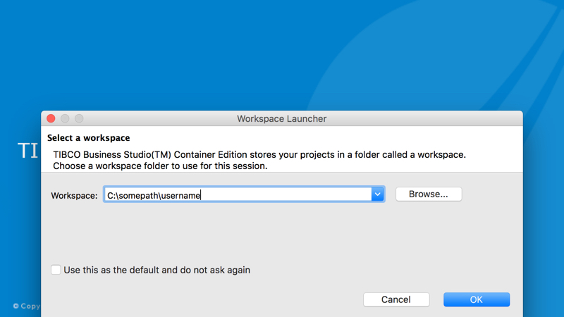
Launching BusinessStudio
Launch Business Studio for BWCE and select /home/tibco/bwce as your project workspace.

Slide 3
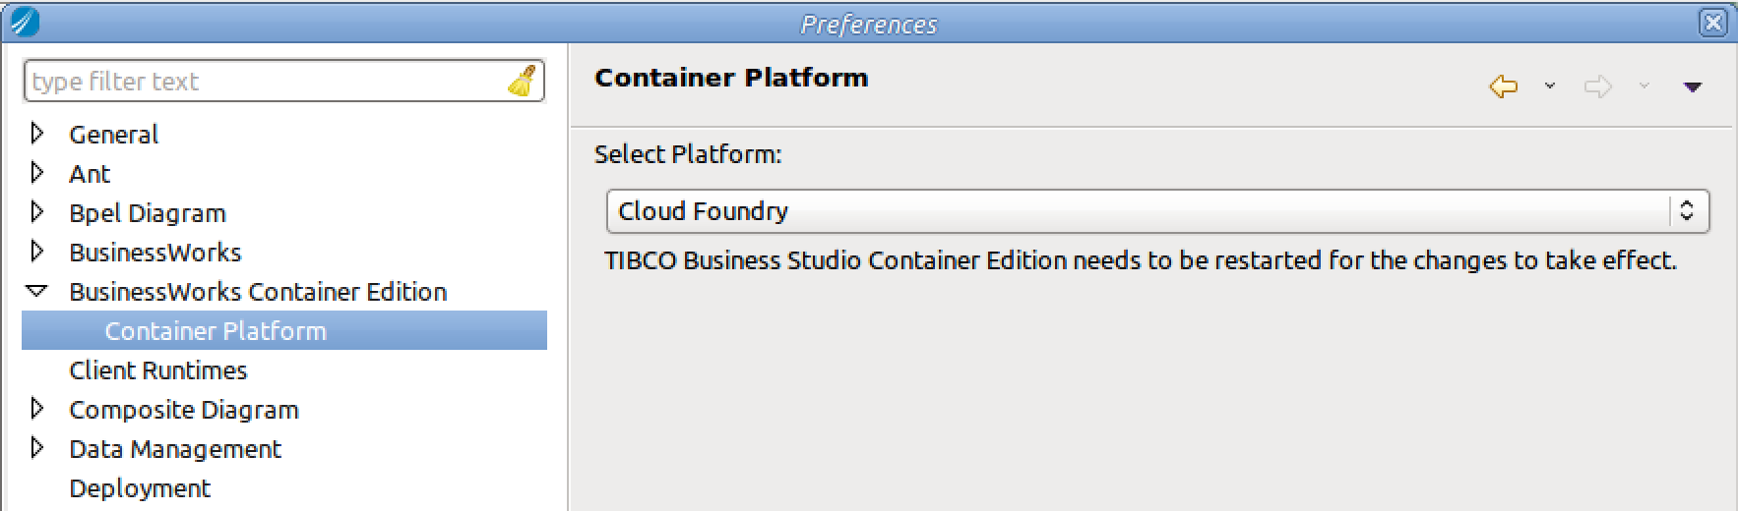
Configure Preferences for Container Platform to Docker
From the top menubar, select Window -> Preferences. This will launch the preferences dialog box.
Navigate in the preferences explorer to BusinessWorks Container Edition > Container Platform. By default it is set to Cloud Foundry. Ensure that the container platform is set to Cloud Foundary.
Click the Apply button and Ok to dismiss the Preferences dialog box.

Slide 4
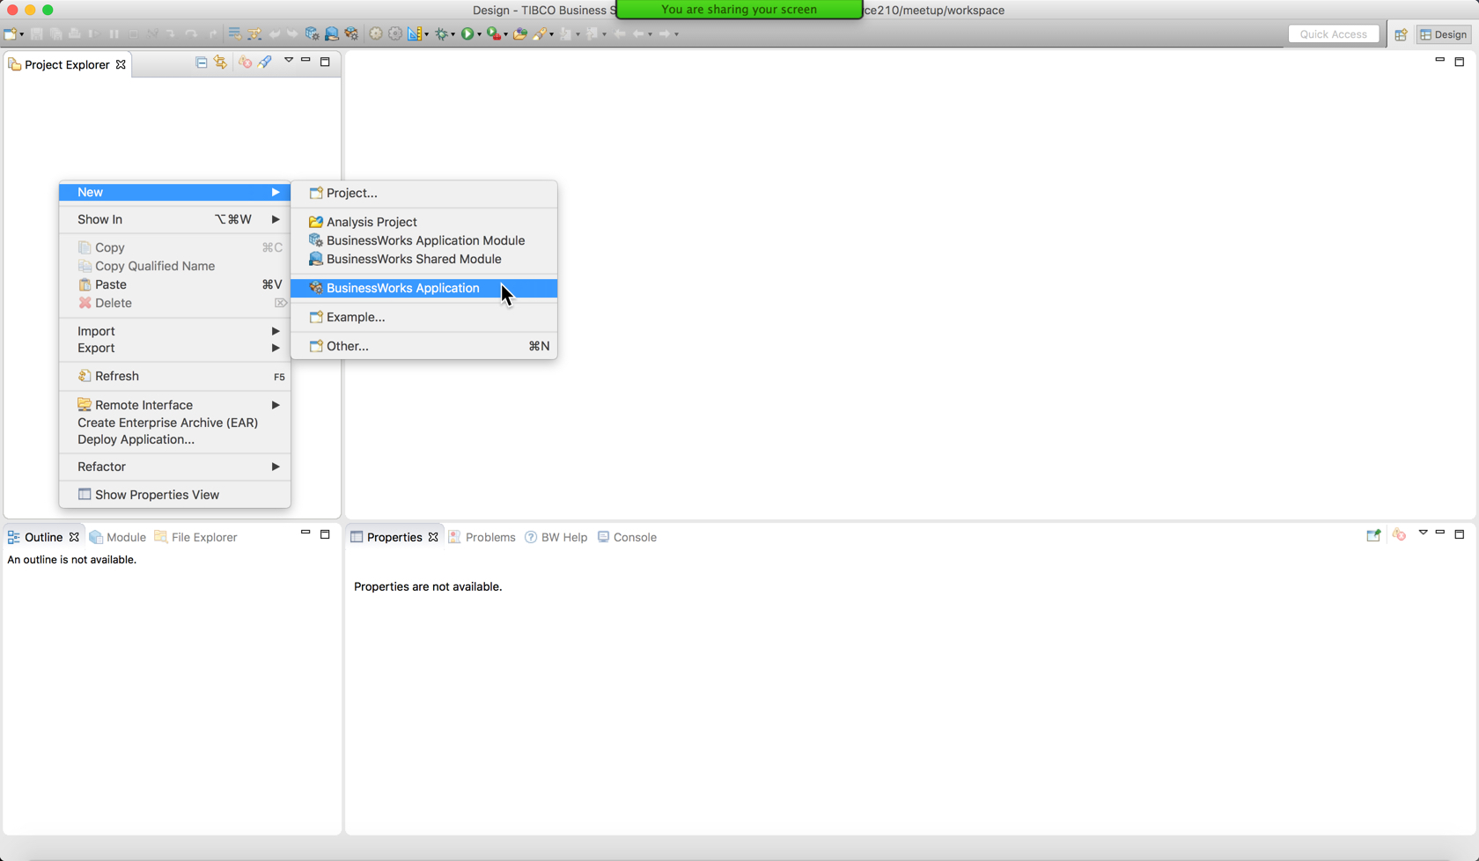
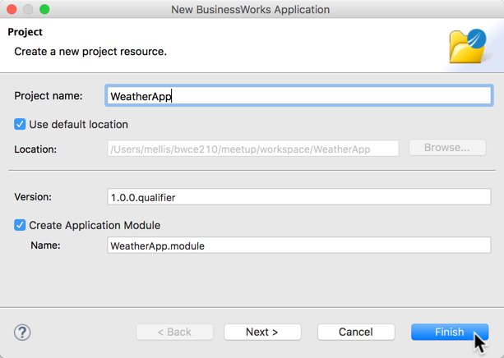
Create a New BWCE Project
Create a new project by clicking file->new->project, then select BusinessWorks Application
Name the project WeatherApp

Slide 5
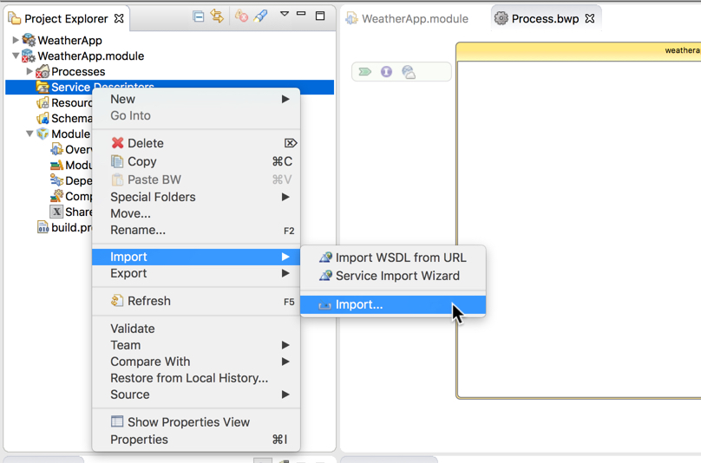
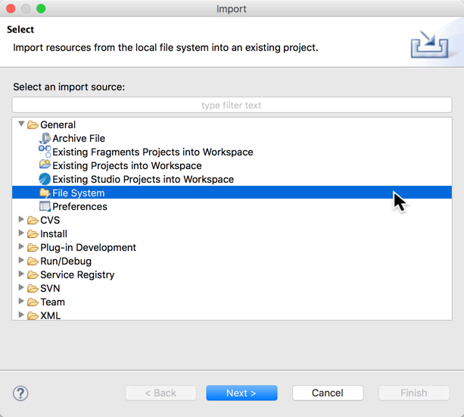
Launching the Import Wizard
In the Project Explorer, select the Service Descriptors folder and then right click and import from General->File System. This will launch the import wizard

Slide 6
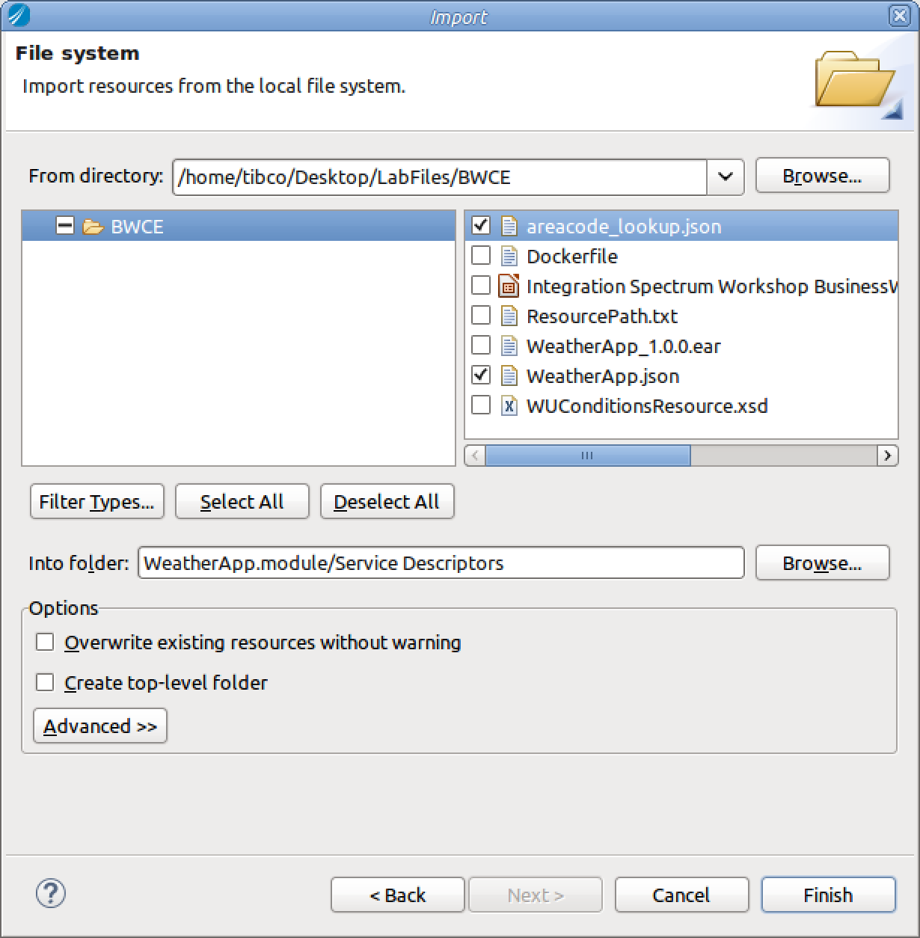
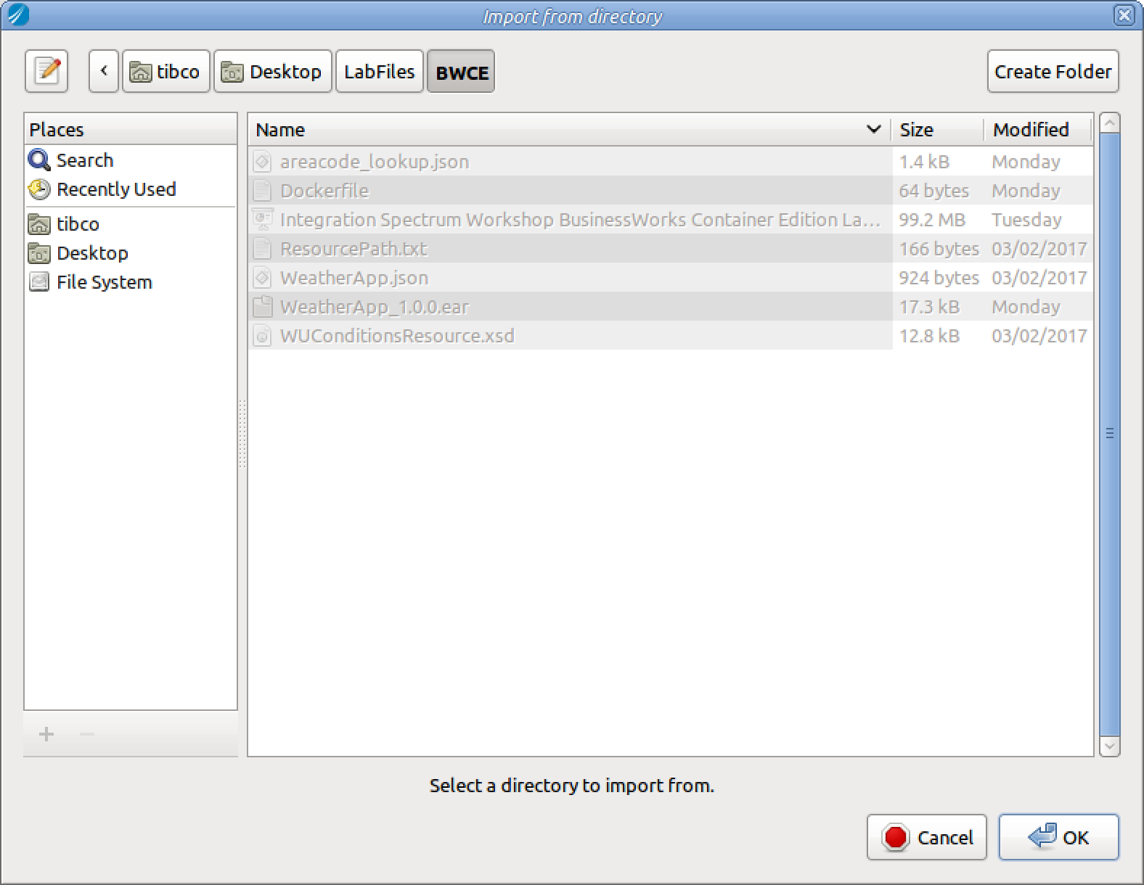
Importing the WeatherApp.json File
1) From the import wizard, click the “Browse…” button (circled in green) and navigate to /home/tibco/Desktop/Lab Files/BWCE. Once you’ve navigated to your lab resources folder, click the open button. This will set the source directory in the Import Wizard.
2) Check the box next to the WeatherApp.json file
3) Check the box next to the areacode_lookup.json file
4) click Finish.

Slide 7
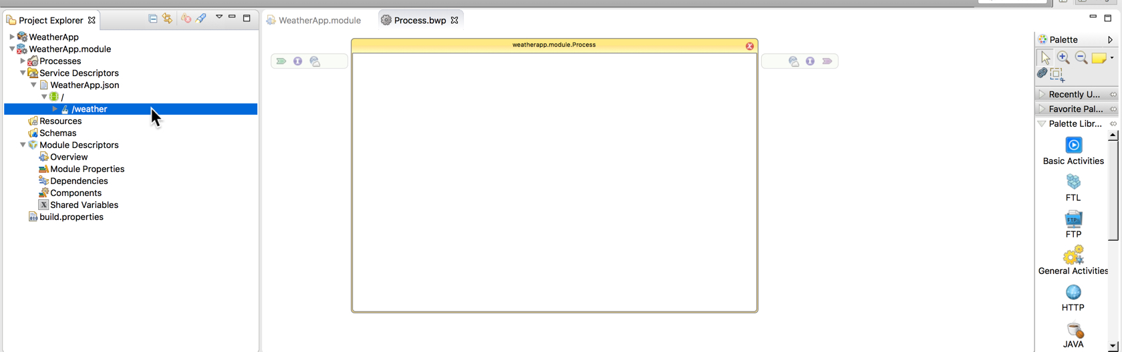
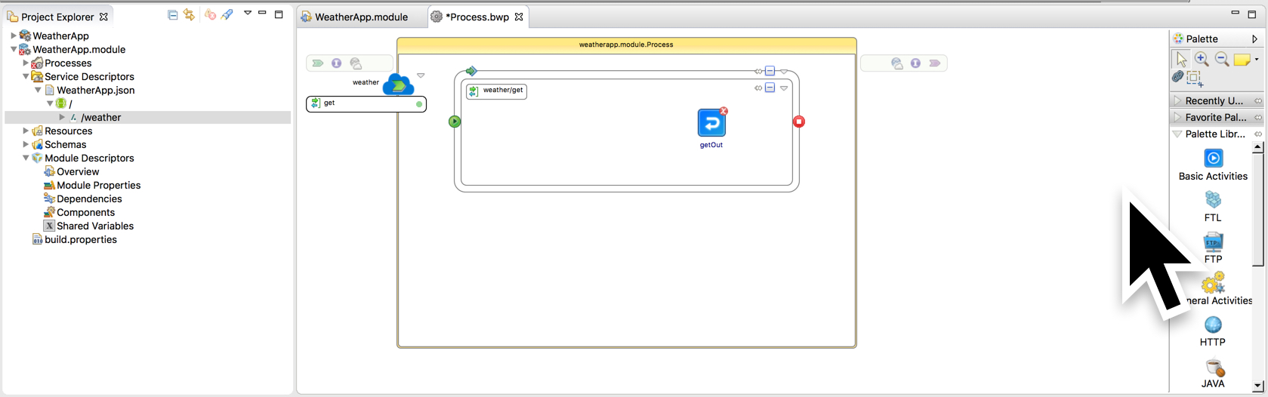
Defining the Weather Service
Fig. 1
Drag this to here
Fig 2.
Navigate in the Project explorer into the newly imported WeatherApp.json object. Navigate down to the /weather element as in Fig 1.
See green annotations in Fig. 1 and Drag and drop the /weather Element into the Process Canvas. You will need to drop it to the left of the process flow box. It should look like Fig. 2, when you’re done.

Slide 8
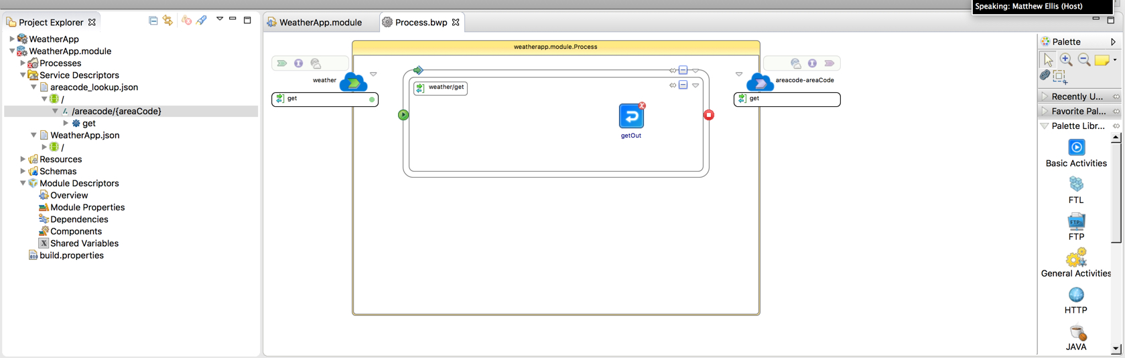
Add /areacode/{areaCode} Service Binding
Drop Here
Drag and Drop the /areacode/{areaCode} operation into the Service Binding section of the Process Canvas
In the Project Explorer, navigate to /areacode/{areaCode} operation and select it.
Drag and drop it into the Process Canvas as annotated above.

Slide 9
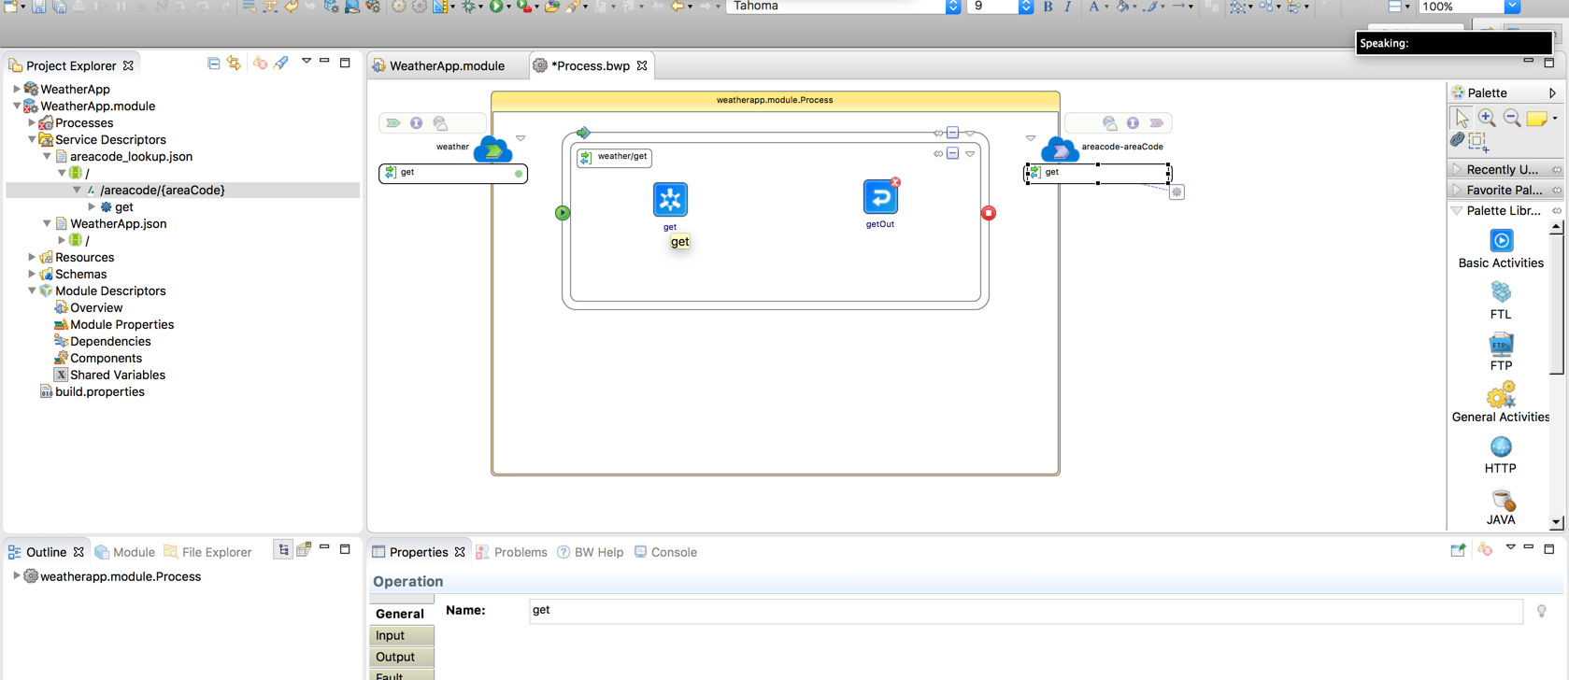
Invoke areacode service
Drop Here
Drag this
In the Process Canvas, click on the ”get” operation circled above in green
Drag and drop it into the Process Canvas as annotated above. This will add the Invoke activity to the canvas as shown above and it will be given a default name of ’get’.

Slide 10
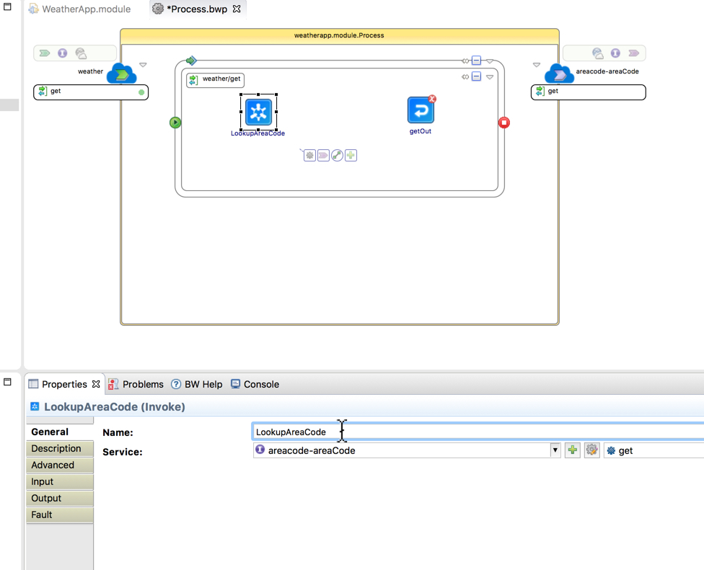
Rename Invoke Activity
Click on the newly added Invoke Activity.
Click on the General tab (Circled in Green) in the Properties Panel and rename Invoke Activity to LookupAreaCode. This makes the process flow in the canvas easier to read and understand.

Slide 11
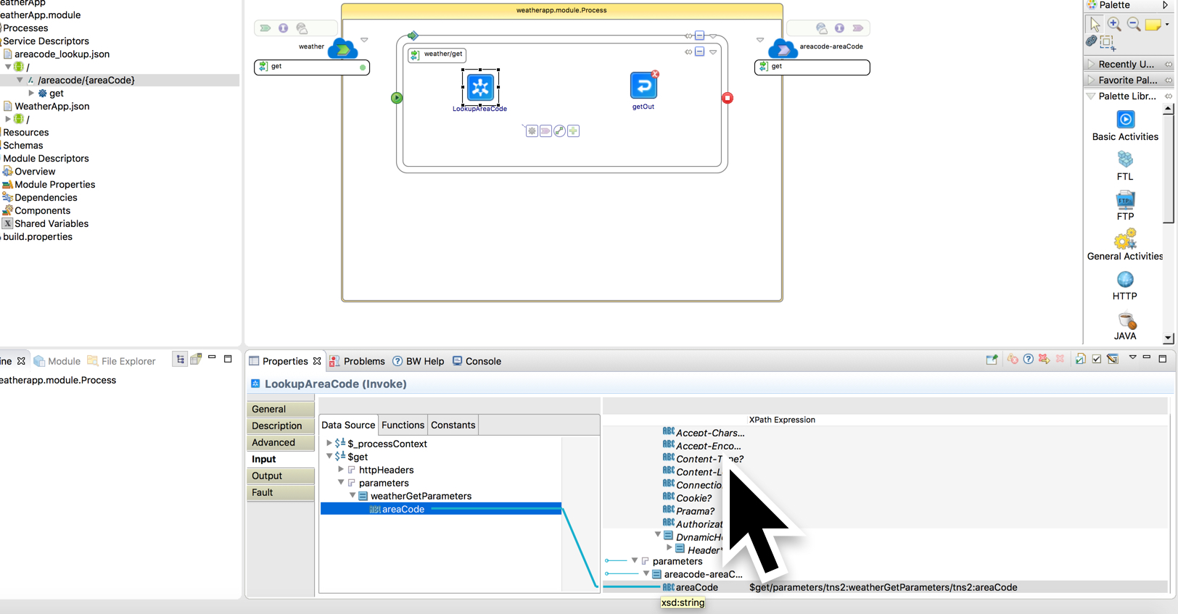
Map areaCode Input XPath Expression
Switch from the General Tab to the Input tab in the Properties Panel. This allows you to pass parameters from a source to a target.
Expand the Data Source Tree to find the weatherGetParameters/areaCode parameter highlighted in blue.
Expand the tree on the right to find the corresponding areaCode parameter. Drag and drop from left to right as shown above.

Slide 12
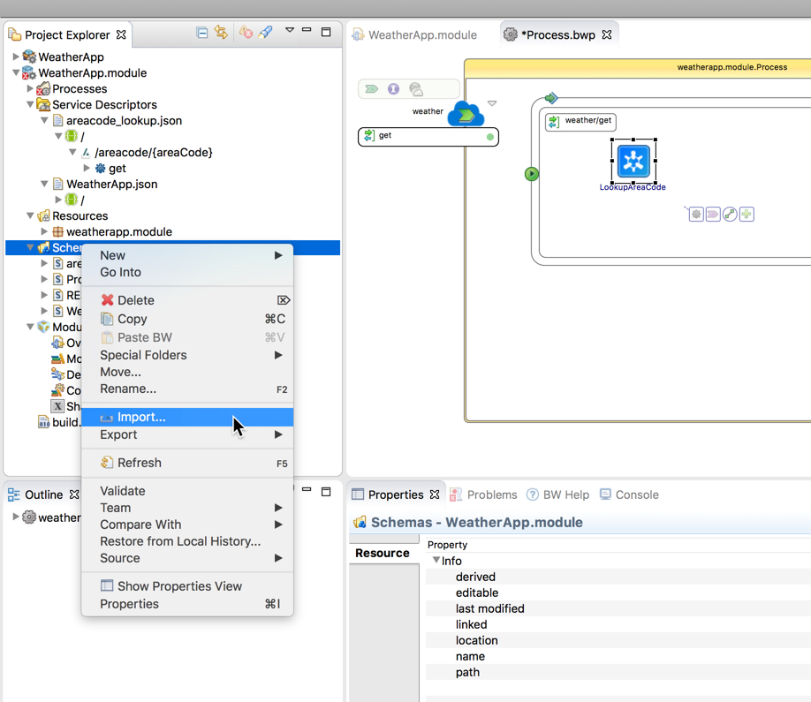
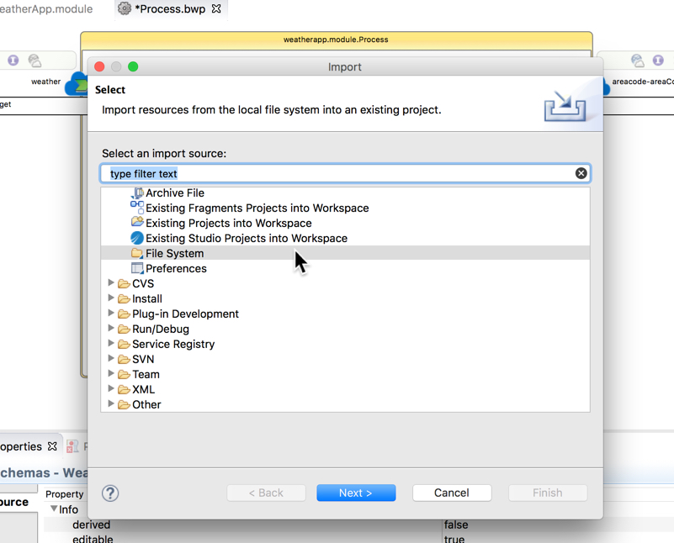
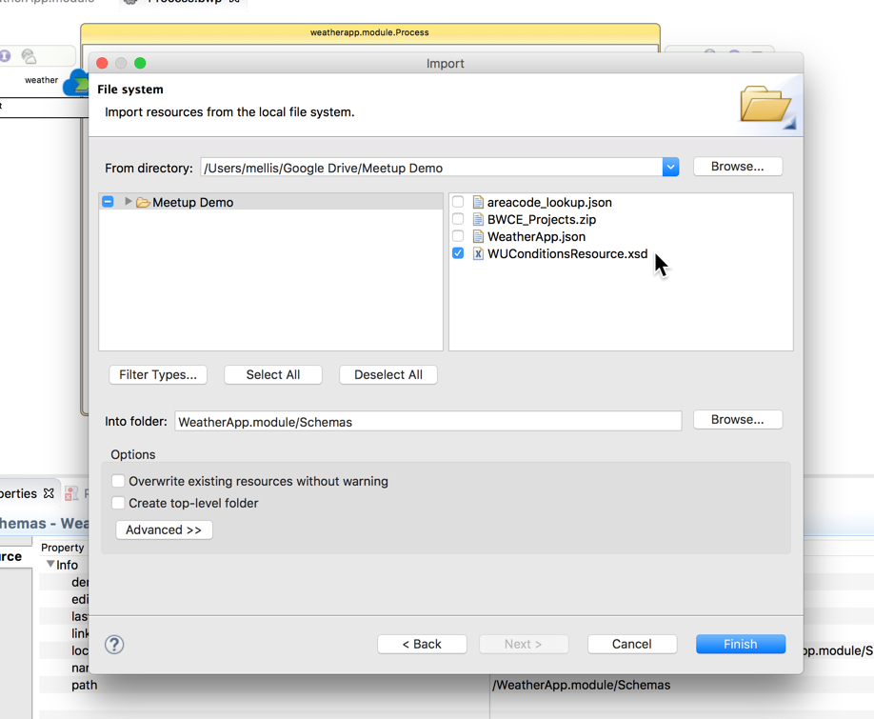
Import WUConditionsResource.xsd Schema from Lab Resources Folder
Next we will import an XML Schema called WUConditionsResource.xsd from the File System. This file is located in the Lab Files Folder on your Desktop.
First navigate to the Schemas folder in the Project Explorer. Then import the WUConditionsResource.xsd file using the Import dialogs as in previous steps.

Slide 13
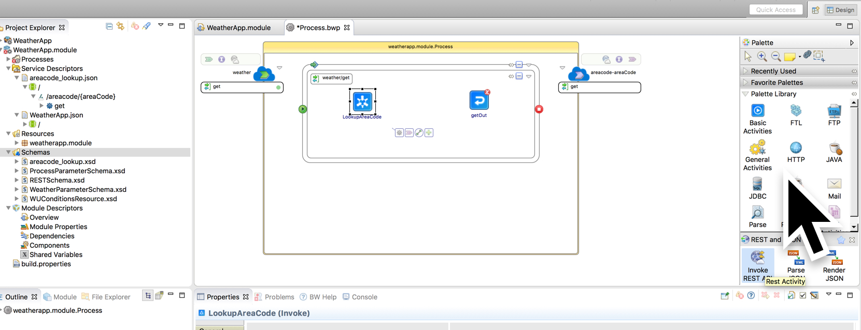
Add an InvokeRESTAPI Activity
Drop Here
Activites Palette
Drag This
Notice the WUConditionsResource.xsd resource is now part of the Schemas Folder in the Project Explorer. It is circled in green above.
Make note of its location in the Project Explorer as it will be needed in a coming step.
Next, select the REST and JSON Palette in the Palette Library (highlighted in blue) and then drag an “Invoke REST API” activity from the “REST and JSON” Palette (as annotated in green above) and drop it in between the LookupAreaCode Activity and the getOut activity above. See annotations in green.

Slide 14
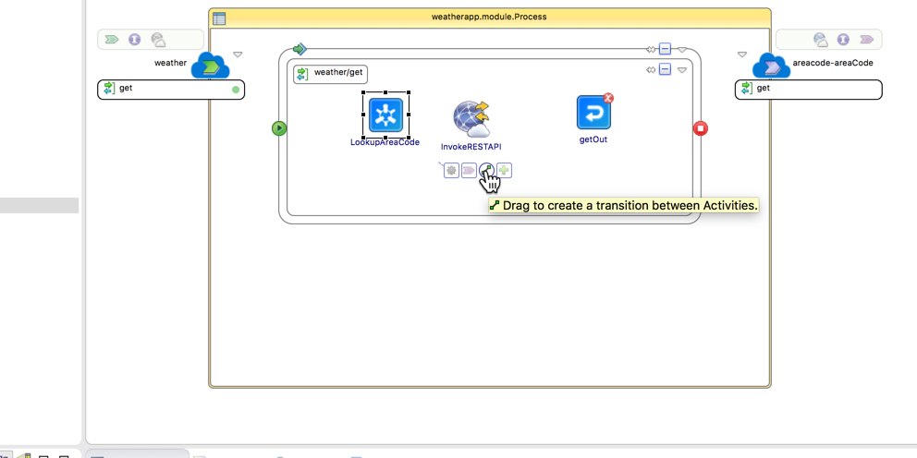
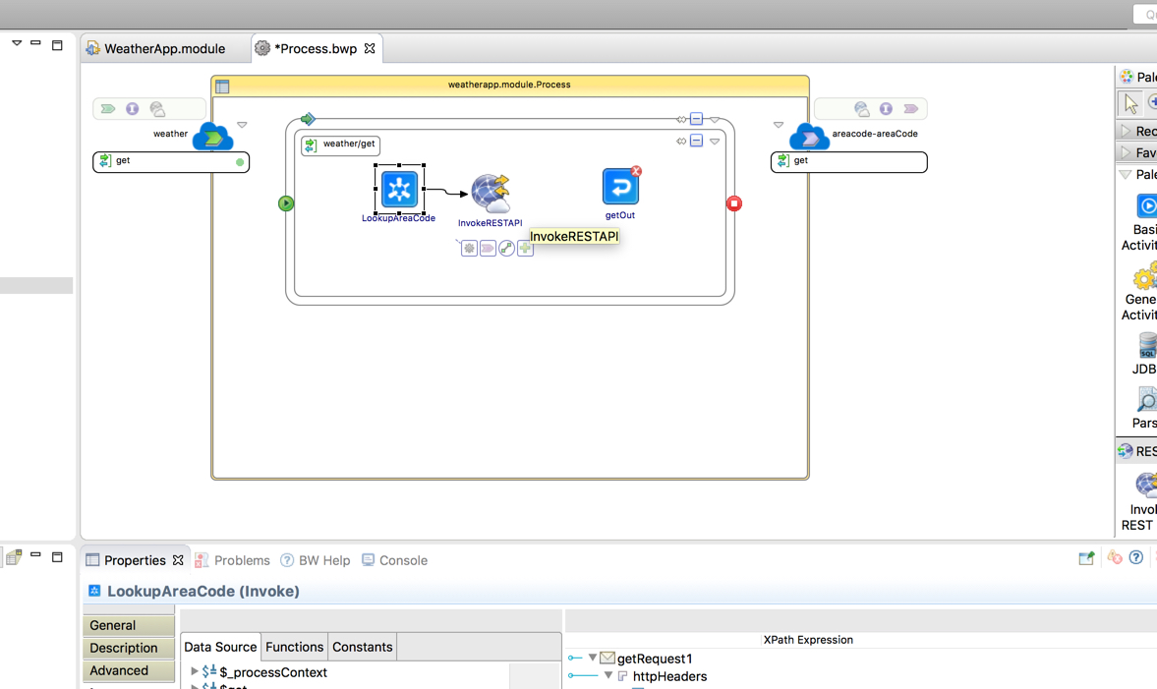
Create a Transition From LookupAreaCode to InvokeRESTAPI
Fig. 1:
Fig. 2
Fig 1.
Fig 2.
Next, create a transition line between the LookupAreaCode activity and the InvokeRESTAPI activity. Transition lines tell the process how to flow from one activity to the next.
Transition lines are directional so it is important to click from the intended first activity to the next. Click on the LookupAreaCode activity to select it and it will display the 4 options in the tooltip above. The third button is for creating a transition. See Fig 1.
Click and drag from the third button to the InvokeRESTAPI activity. You will see a line appear that goes from the LookupAreaCode activity to the InvokeRESTAPI activity as shown in Fig 2.

Slide 15
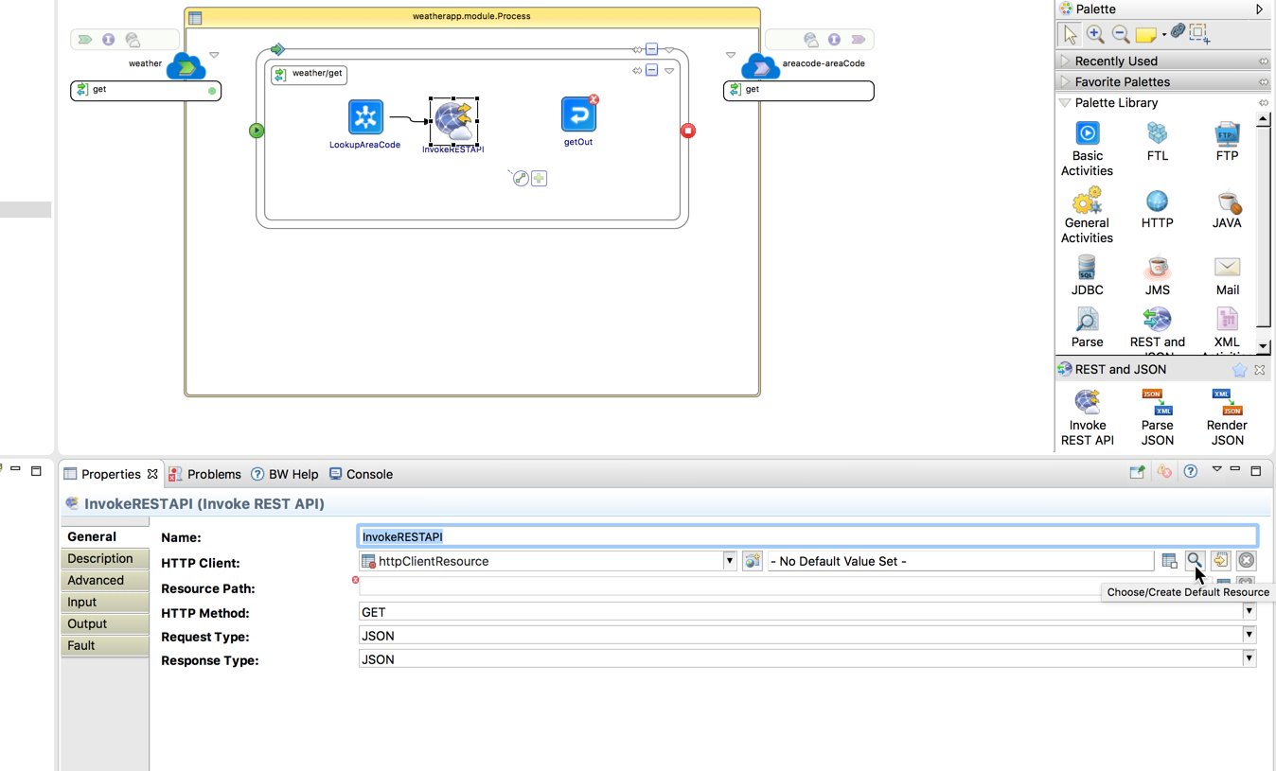
Define an HTTP Connection Resource to be used by the InvokeRESTAPI
Next, we will define an HTTP Connection Resource that will be used by the InvokeRESTAPI to connect to the WUnderground service.
To do this, click on the magnifying glass (circled in green) in the properties panel. This will launch a dialog box that will let us create a connection resource.

Slide 16
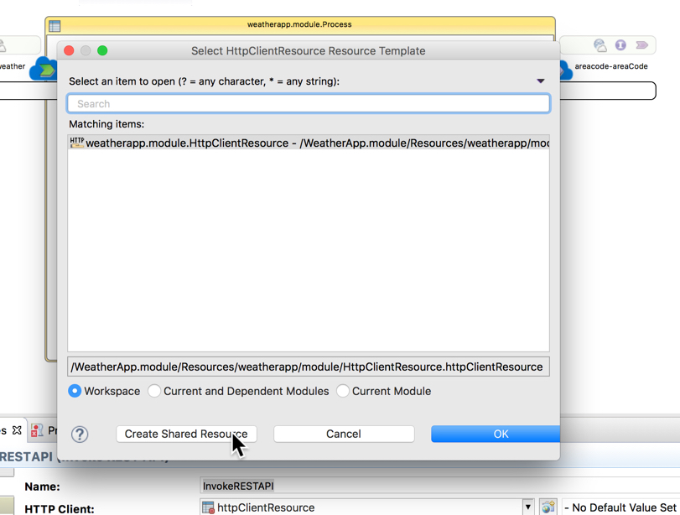
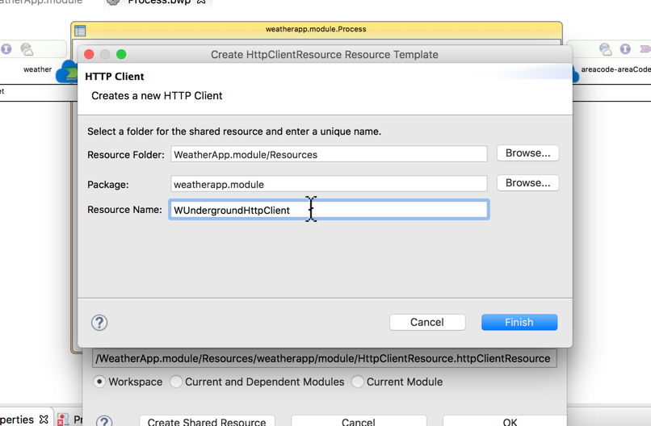
Define an HTTP Connection Resource to be used by the InvokeRESTAPI
Fig. 1:
Fig. 2:
Fig 1.
Fig. 2
Click the ”Create Shared Resource” button as in Fig 1. This will bring up the dialog box in Fig 2.
Enter the Resource Name WUndergroundHTTPClient and click Finish

Slide 17
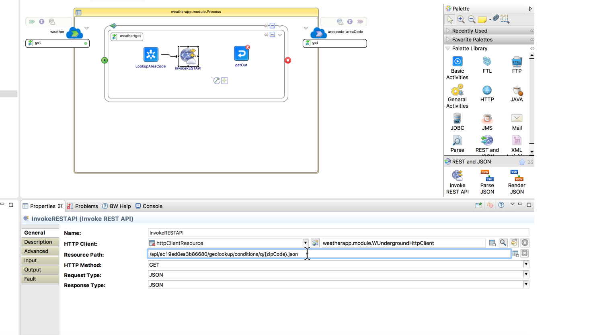
Set HTTP Connection Endpoint Parameters
Fig 1.
Set the Resource Path property highlighted above to be “/api/ec19ed0ea3b86680/geolookup/conditions/q/{zipCode}.json”. This is the URL suffix that is added to the WUnderground server’s name to invoke the weather service. This resource path is also in a file named ResourcePath.txt in your BWCE Lab Folder.
Next, click on the Edit Default Resource button (circled in green above). This will open a Project Tab in the Canvas Panel to let us fill in the WUnderground Server and Port information.

Slide 18
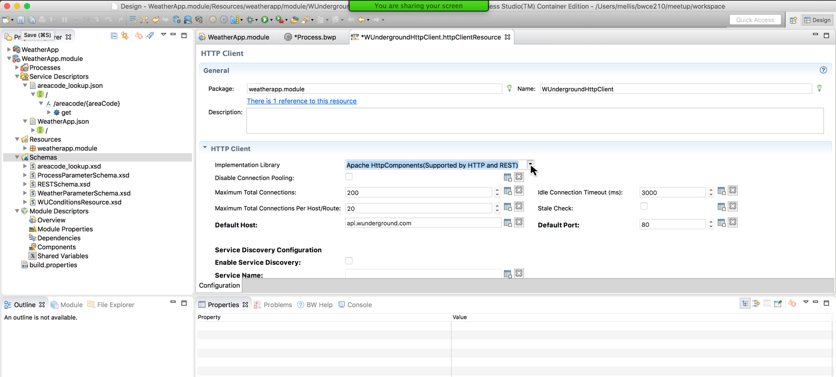
Set HTTP Connection Endpoint Parameters
Notice that you are now in a new tab called WundergroundhttpClient.httpClientResource as circled in green above.
Select the drop-down list for Implementation Library and set it to HTTP and REST as shown above.
Set the Default Port to 80 as shown above. Might already be defaulted to 80. This is fine.
Set the Default Host to ”api.wunderground.com”
File->Save All, then close the current tab and select the Process.bwp tab.

Slide 19
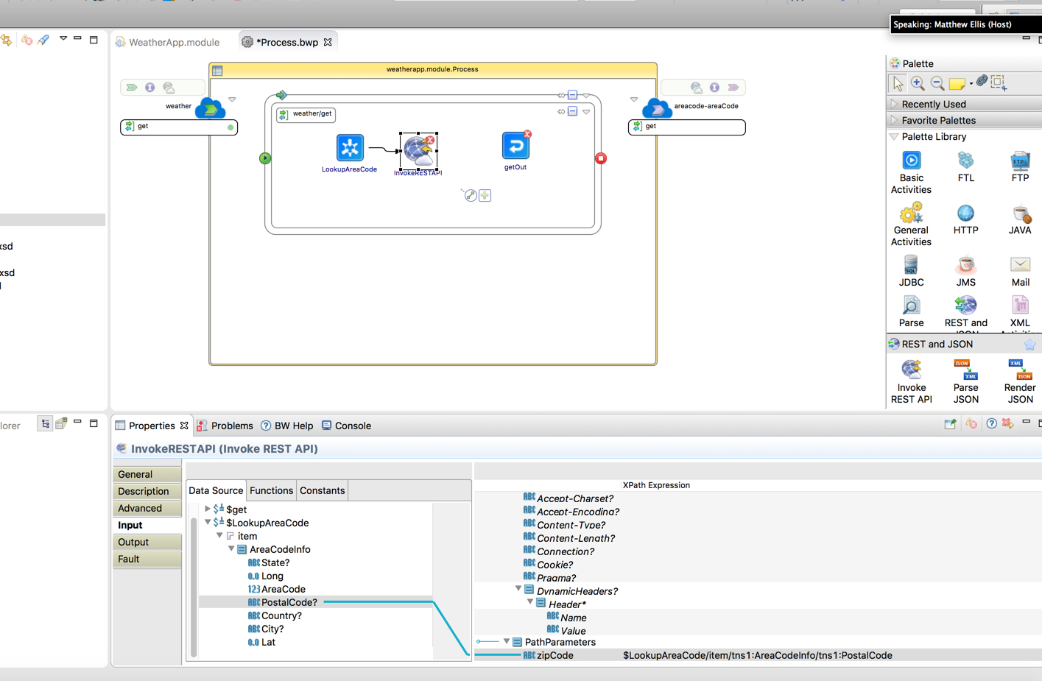
Map zipCode Input Parameter for InvokeRESTAPI Activity
Click on the InvokeRESTAPI in the canvas to select it. Then click on the “Input” Tab in the Properties Editor. See green circles above.
Map PostalCode to zipCode as shown in the mapper diagram above.

Slide 20
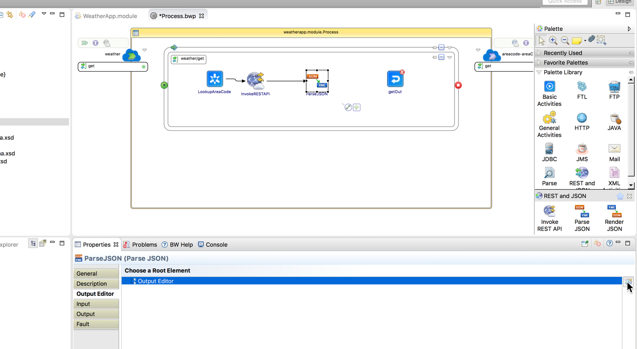
Add/Configure a Parse JSON Activity
Output Editor Element
Select the REST and JSON Palette (highlighted in blue) and then drag-and-drop a ParseJSON activity from the Palette to the Canvas (circled in green).
Add a transition from InvokeRESTAPI to the new ParseJSON activity.
Select the Output Editor Tab (circled in green) and click the “Select Output Editor Element” button (circled in green). This will open a dialog box called “Select Schema Element Declaration” on the following slide.

Slide 21
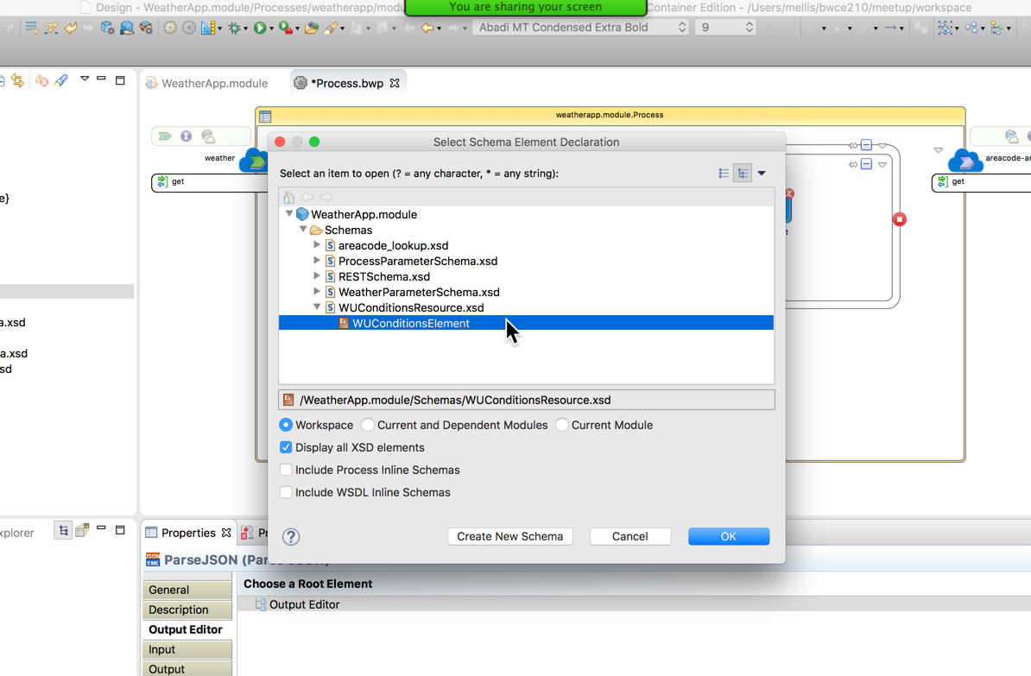
Configure Output Schema for Parse JSON Activity
Navigate in the ”Select Schema Element Declaration” dialog box to the WUConditionsElement and select it. This will define the root element of the ParseJSON activity.
Click on OK to finish the selection.

Slide 22
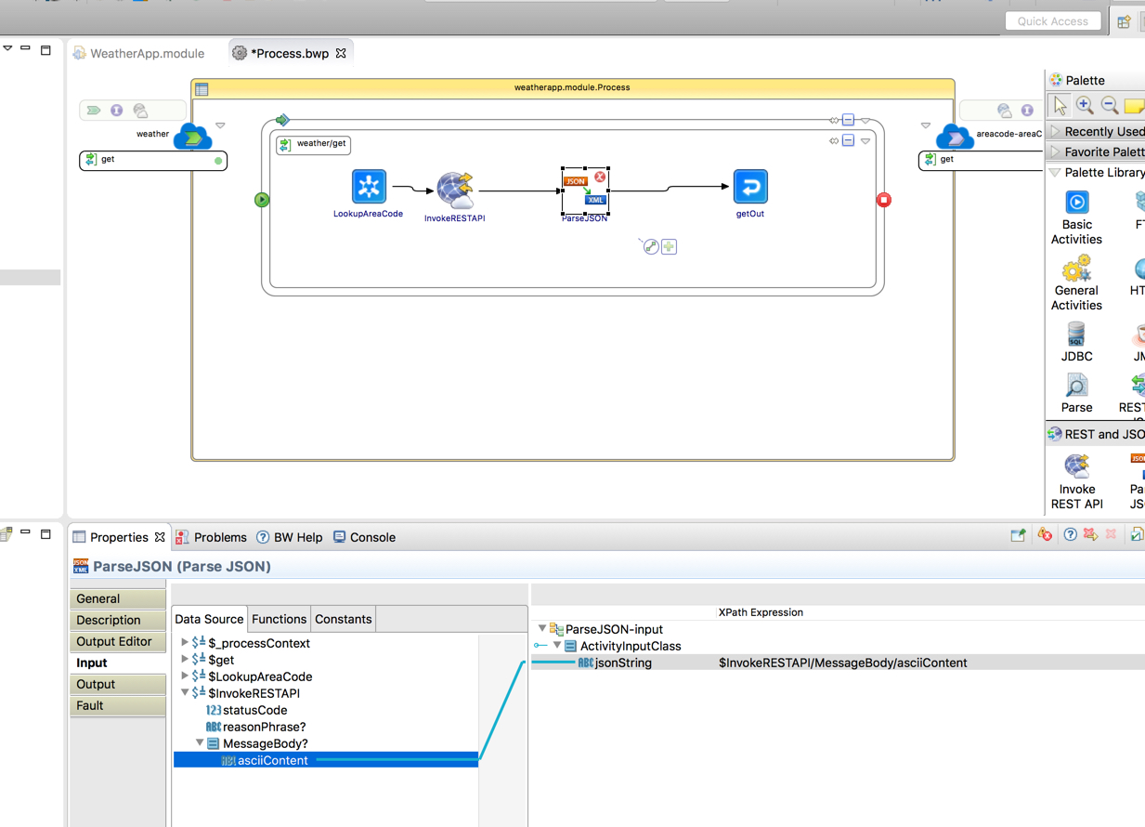
Map Input Parameters for Parse JSON Activity
Next we will map the output of the InvokeRESTAPI activity to the input of the ParseJSON activity.
To do this, first select the ”Input” tab in the properties panel. (small circle in green)
Then, drag and drop the asciiContent node to the jsonString node as shown above (big circle in green)

Slide 23
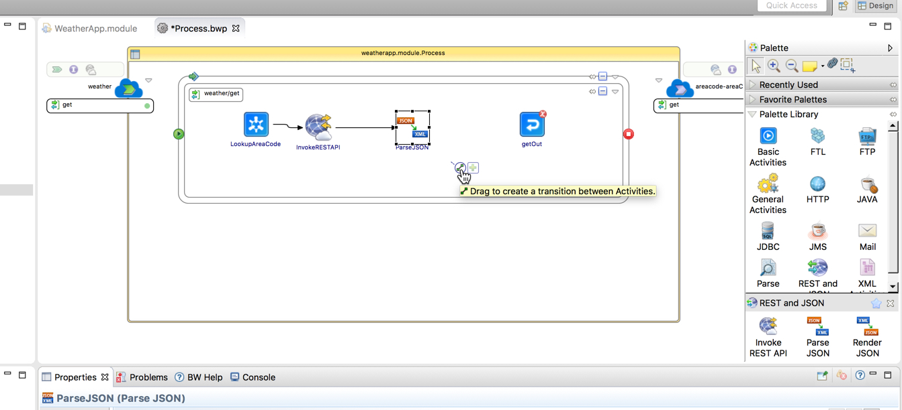
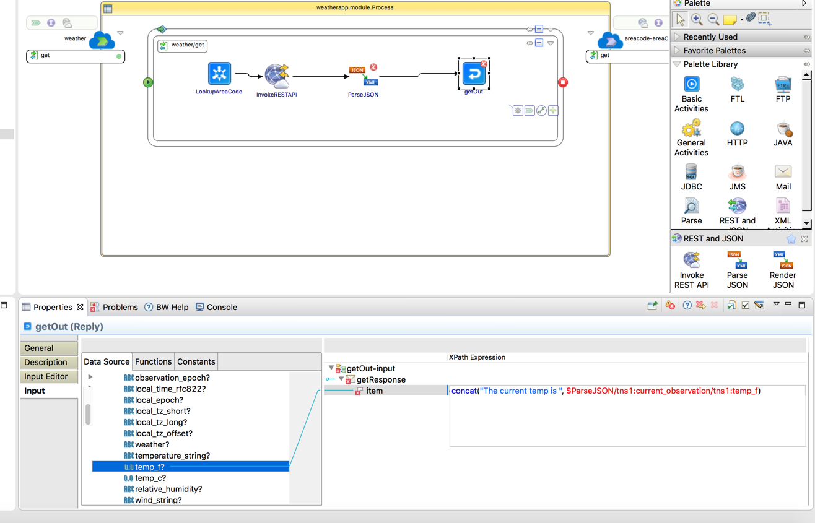
Create Transitions and Define XPath Expression for Output
Select the ParseJSON activity and drag a new transition to the getOut activity.
Click on the getOut activity and then click on the input tab (small green circle)
On the ”Item” node type in “concat(”The current temp is: “, x)
Drag and drop from the temp_f node onto the ’x’ you just typed. It will replace the ’x’ with the temp_f node

Slide 24
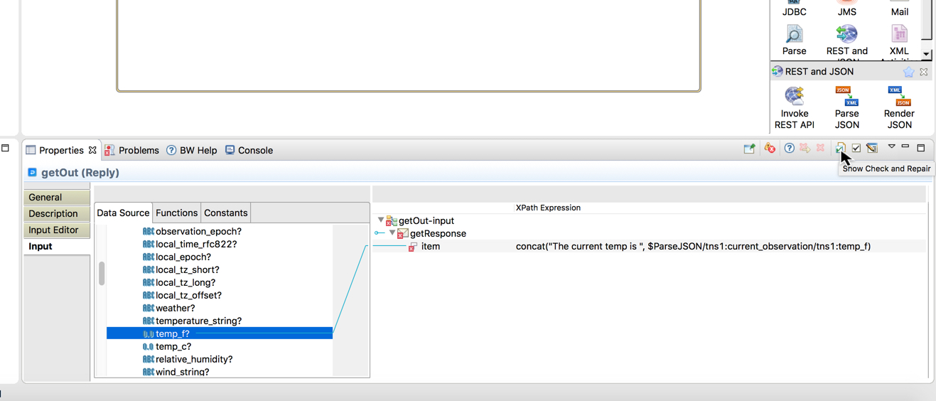
Use the Xpath Check and Repair Tool
Note that the mapping is done correctly however the expression will be highlighted in red. This is because the concat() Xpath operator is expecting a string and you are passing the temp_f node which is a float.
Click on the “Show Check and Repair” button to have the mapper cast the float value into a string
Clicking on this button will launch the Mapper Check and Repair dialog on the next slide

Slide 25
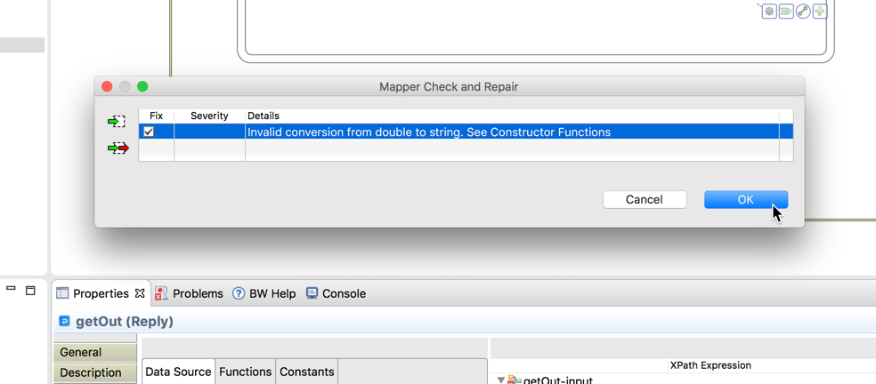
Automatically Correct the XPath Errors
When the “Mapper Check and Repair” dialog opens, put a check mark in the box next to the error. (Circled in green)
Click the “Ok” button and the mapper will apply the necessary XPath cast operation to resolve the error.
Click on File->Save All to save your project

Slide 26
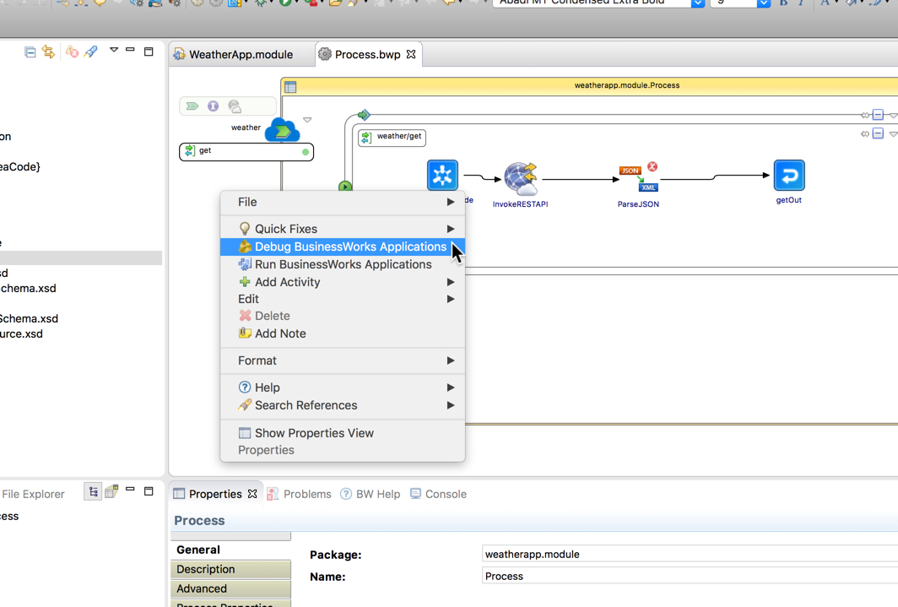
Launch the Debugger to Test the Service
Right Click in the canvas and select “Debug BusinessWorks Application”. This will launch the process in debug mode.

Slide 27
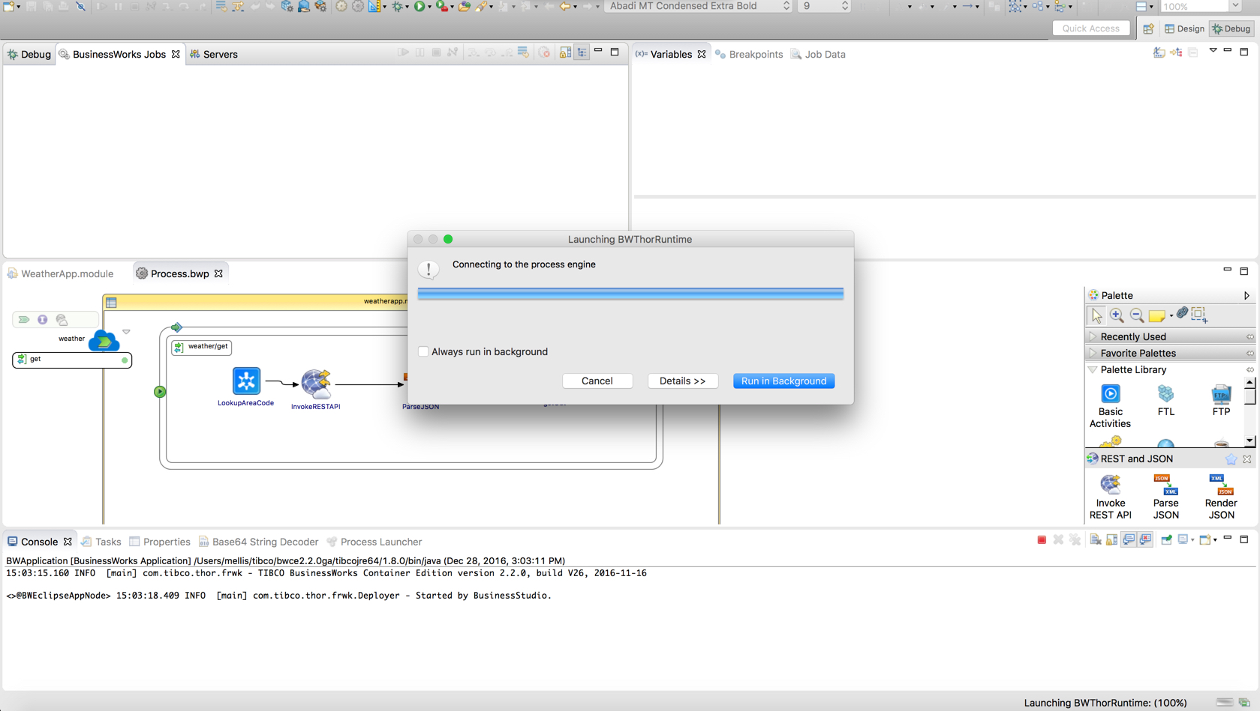
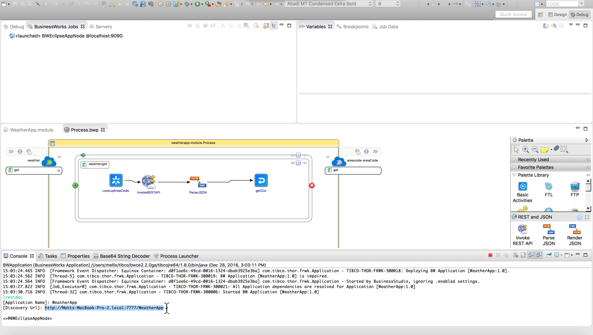
lrestdoc Command and Copy-Paste WeatherApp URL
The “Launching BWThorRuntime” dialog box will be displayed. Just let it run and watch the text messages in the lower Console pane. (Circled in green)
Once you see the Console message “Started BW Application”, type in the command ”lrestdoc” and hit enter.
Copy the URL with Ctrl-C

Slide 28
Browse to WeatherApp URL
Fig. 1:
Fig. 2:
Open up a new browser window and paste in the URL you just copied.
Replace the hostname with “localhost”. The Browser URL should be http://localhost:7777/WeatherApp as in Fig. 1
Similarly replace the hostname in Fig. 2 (circled in green) with ”localhost”
Click the Expand Operations link

Slide 29
Browse to WeatherApp Client URL and Try It Out!
Enter a US-based Phone Area Code such as 214 (Texas)
Click the “Try It Out!” Button.
Congrats you’ve built and tested a deployable BWCE project!

Slide 30
Stopping the Debugger
Now that WeatherApp has been tested, stop the debugger by clicking the red square circled in green above.
Switch back to the Design perspective (tab circled in green above)

Slide 31
Creating the Deployment (.ear) File
In the Project Explorer, navigate to WeatherApp->Package Unit->Overview. Double-click on Overview to open the Overview configuration screen. Name the ID WeatherApp.
Click the Export Application for Deployment link. This will launch the EAR Export Dialog. Click the ”Browse…” button and specify the Lab Resources folder to store the *.ear deployment file. Using the Lab Resources folder will make the docker build convenient because everything will be in the same folder.
Check the box to Use Default EAR file name and click the finish button.

Slide 32
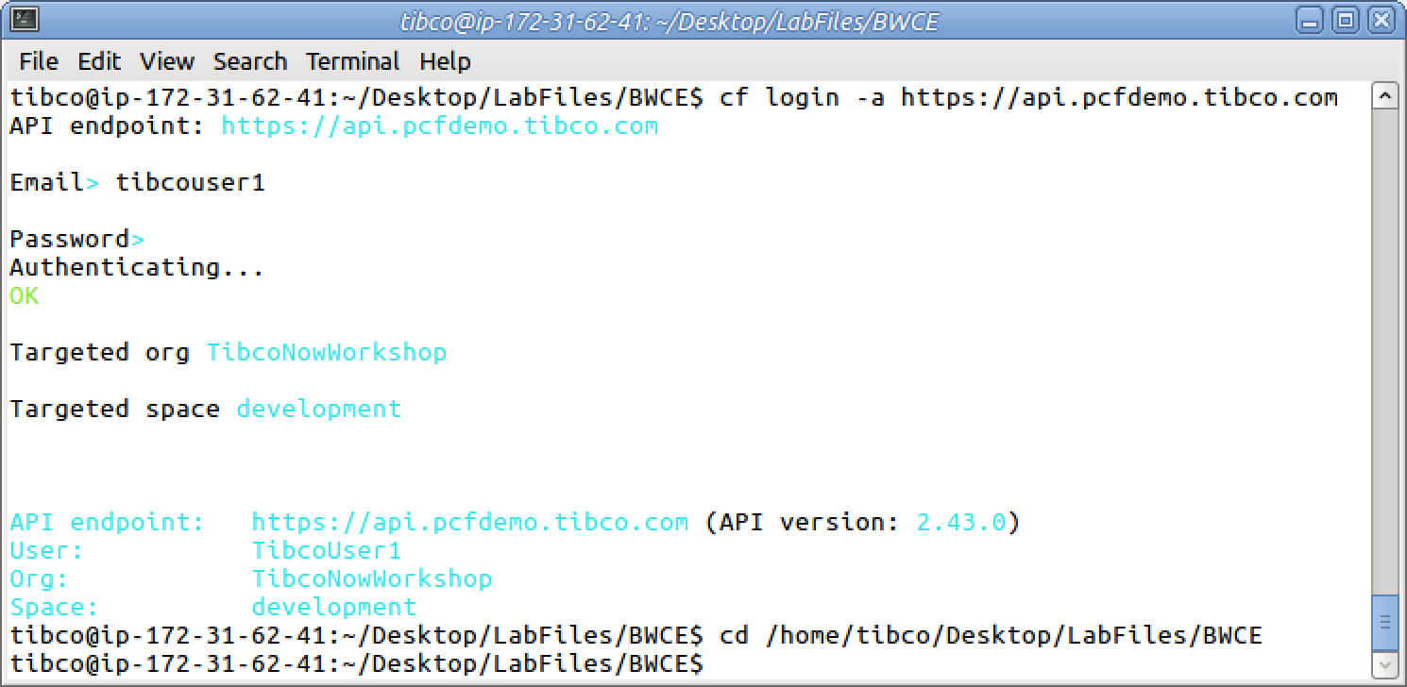
Logging into Cloud Foundry
In a Terminal Window, enter the command ”cf login –a https://api.pcfdemo.tibco.com ” and hit enter. This will log you onto the demo Cloud Foundry Instance.
Enter the PCF username and password provided on your lab information sheet.
Change your directory by entering the command “cd /home/tibco/Desktop/LabFiles/BWCE”

Slide 33
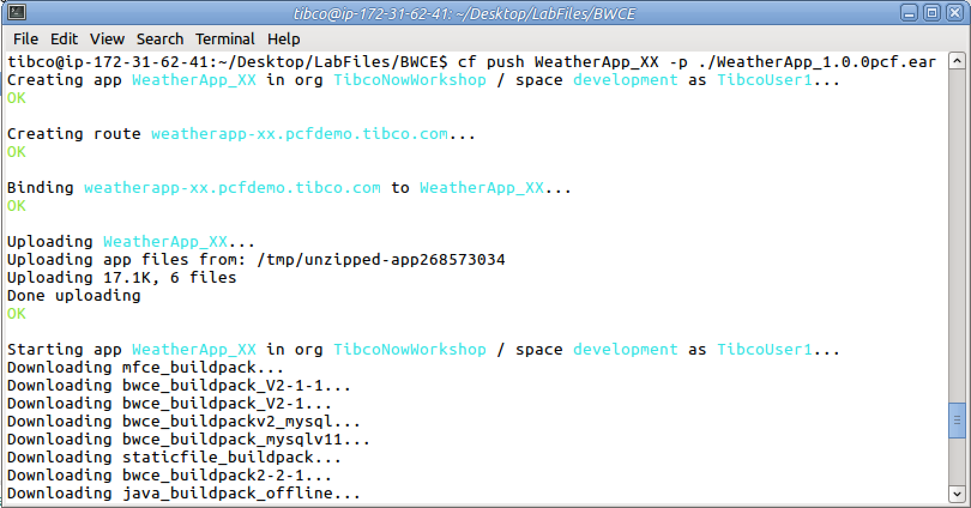
Pushing an Application to Cloud Foundry
Push your application to Cloud Foundry using the following command:
cf push WeatherApp_XX –p ./WeatherApp_1.0.0.ear
Where XX is your initial (Needed to for unique application on the same instance)

Slide 34
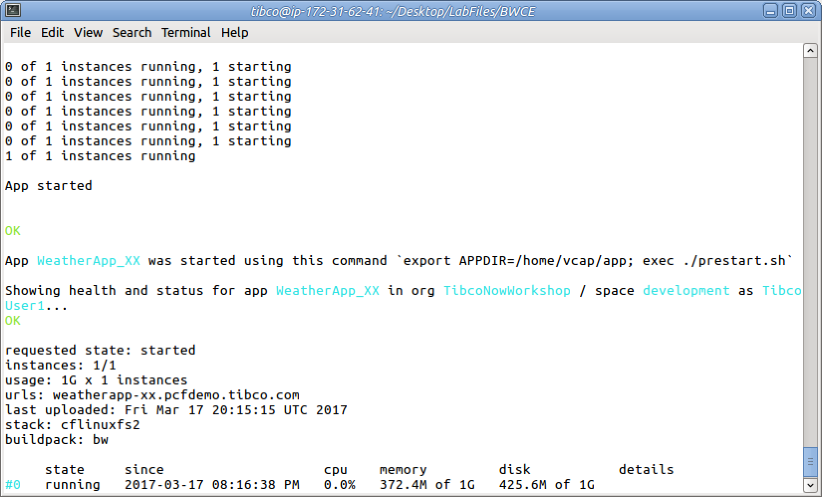
Pushing an Application to Cloud Foundry
Wait for the application to start successfully.

Slide 35
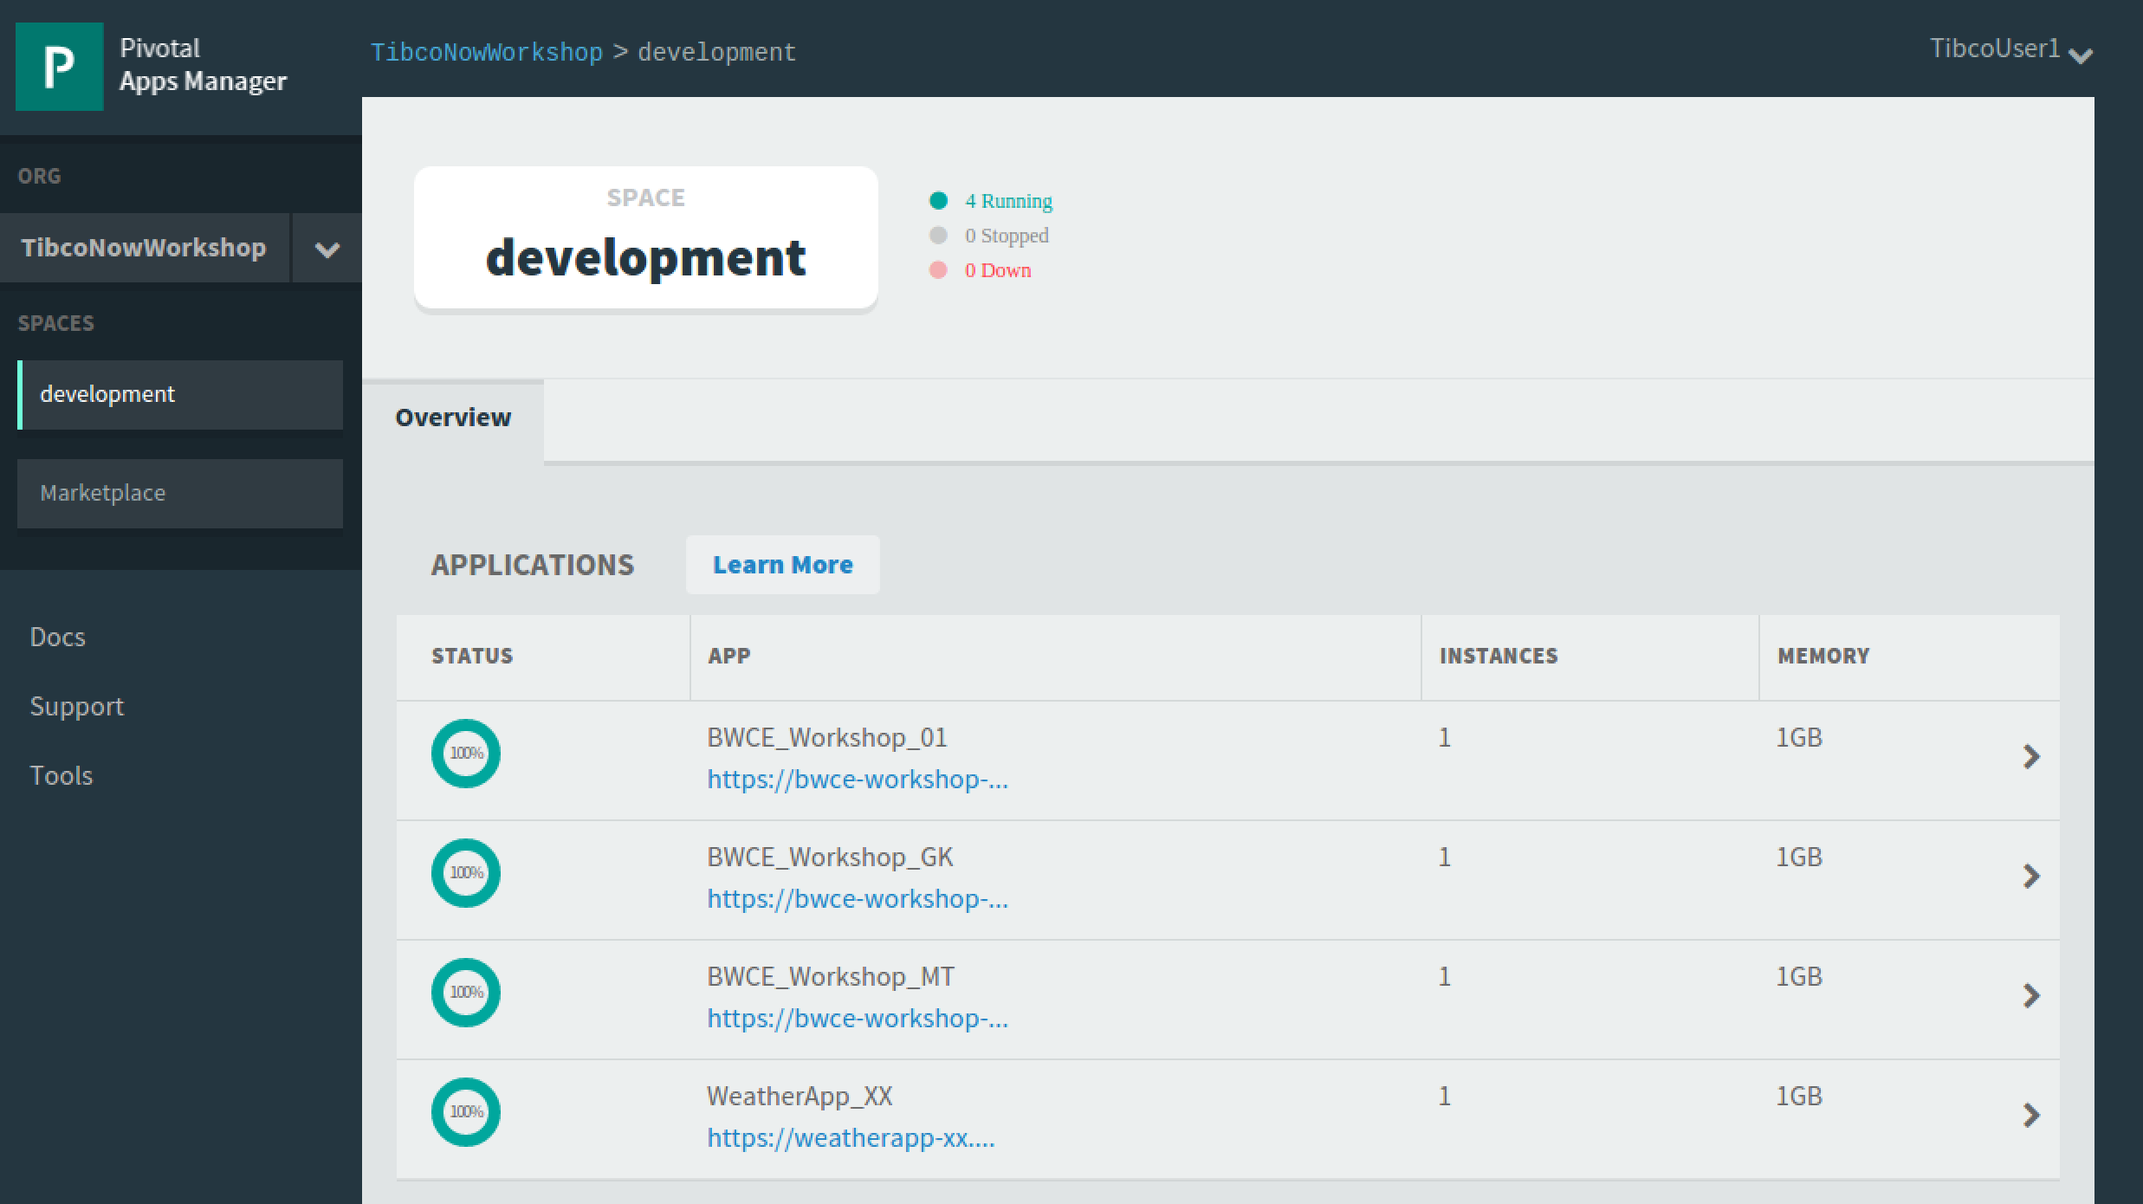
Using the Cloud Foundry Development Console
Login to the PCF Development Console at https://login.pcfdemo.tibco.com using the PCF Username and Password on your Lab Information Sheet.
Select the Development tab.
Click on App name WeatherApp_XX to open your Application.

Slide 36
Using the Cloud Foundry Development Console
Copy your application URL and paste it into a browser, appending “/swagger” to bring up the built in swagger test client.

Slide 37
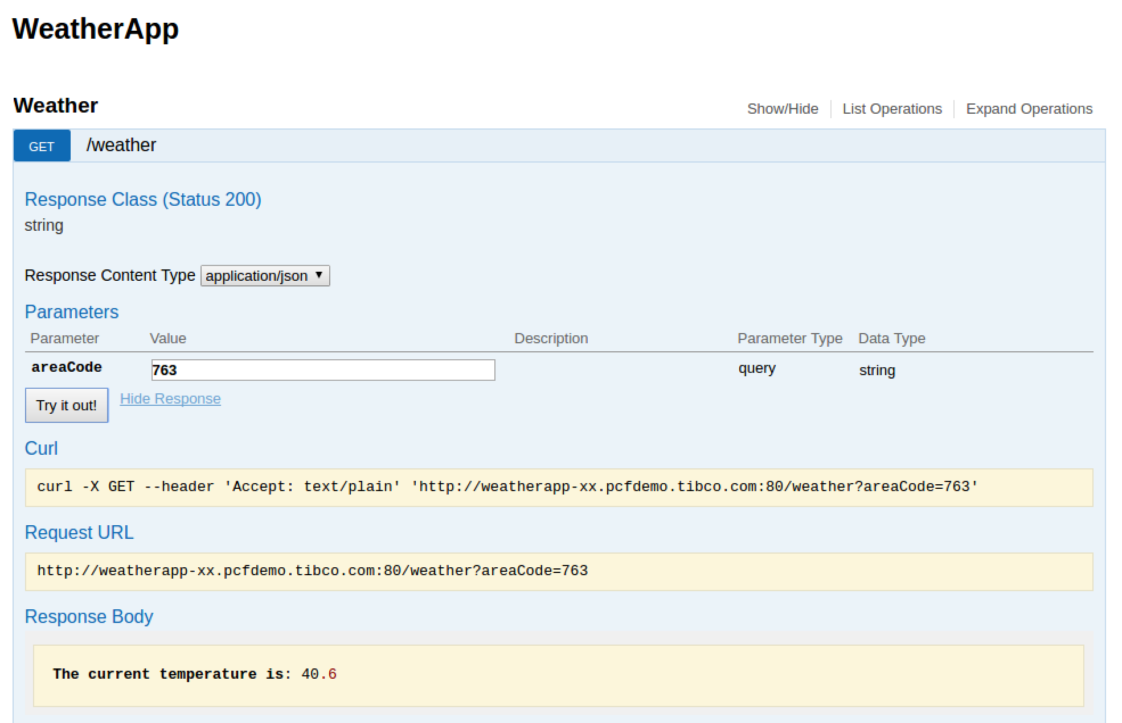
Using the Cloud Foundry Development Console
Expand the Weather service.
Enter an area code such as 214 and click the “Try it out!” button. Look at the Response Body for the string “the current temp is: xx”.
Congrats, the WeatherApp is now deployed to Cloud Foundary and running successfully!

